Slide 1
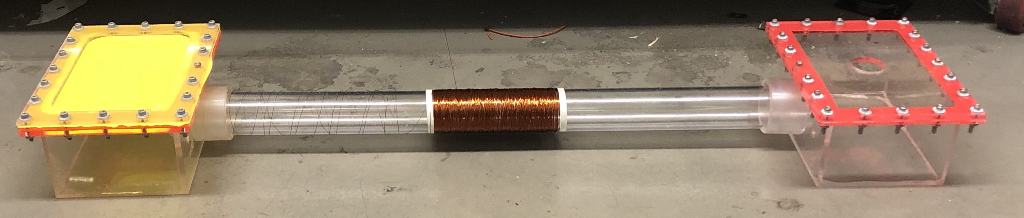
Design and Evaluation of a Two-Membrane Wave Energy Converter
Bryce Rogers
BS Mechanical Engineering

Slide 2

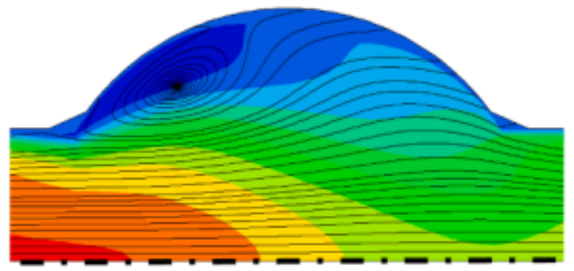

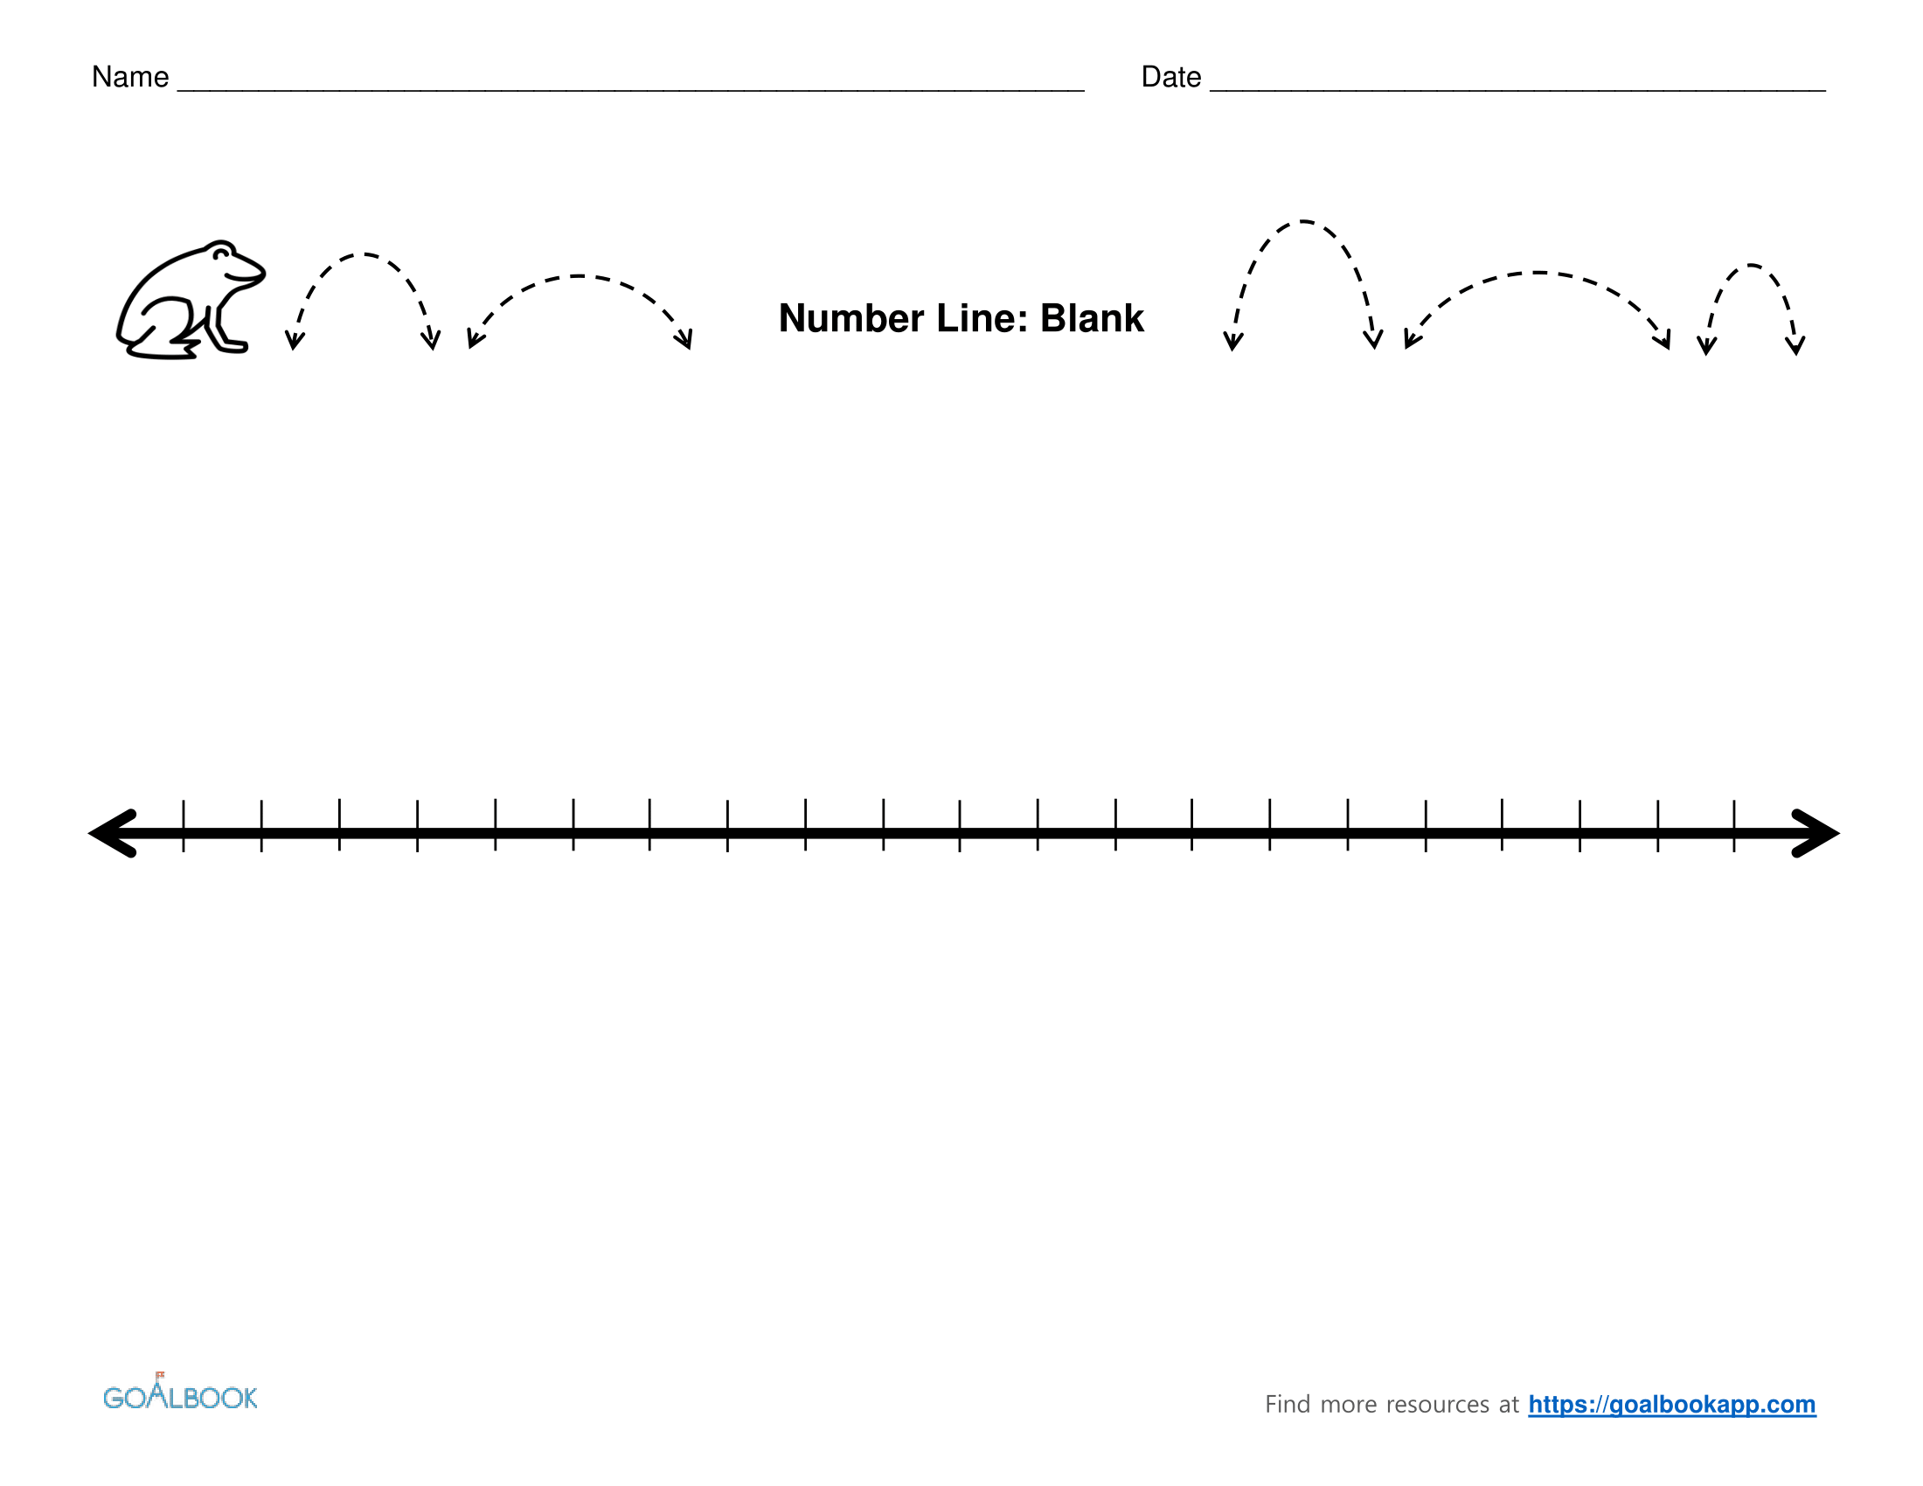


About Me
‘13
‘17
‘18
‘22
Gap year
Notes:
Grew up in Pleasanton, east bay
Attended AV
Always knew I was stemmy, but didn’t choose major til later
Gap – family + work
Ames, butler, tutoring
Bay -> la, usc, mech E
Tutoring, internship, 2.5 years of research
Graduated, hieng
Describe HIEng in detail
Just received EA funding

Slide 3
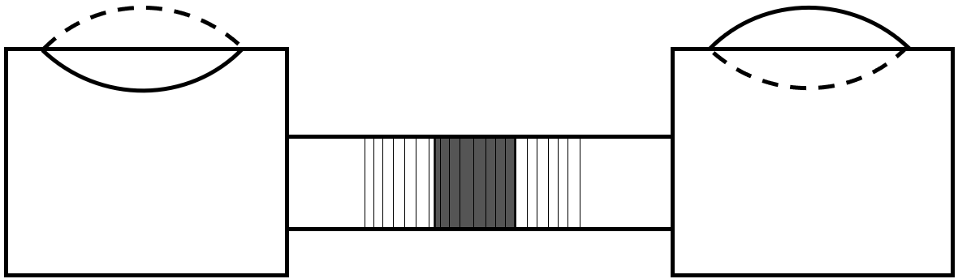

Honorable Mentions
Hardware
Technical Complexity
Notes:
AV smash
proud, but neither technical nor hardware
HIE
Just discussed in detail. Not an engineering problem – operations, community building, leadership
Ames
decent amount of hardware and tech complexity
Split among many projects/teams
Rapid prototyping, taught myself solidworks, some fabrication and assembly
Research
Not hardware, but among the most challenging technical problems ive worked on
The actual WEC

Slide 4
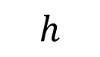
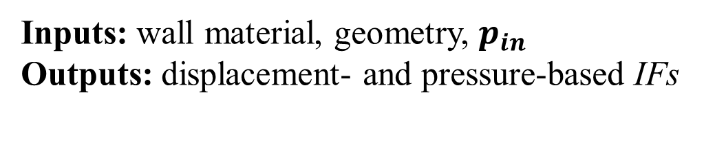
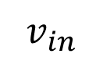
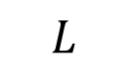
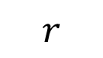
Biomechanical Research – Paper 1
Boundary Model
$$L$$
Axisymmetric aorta model
$$v_{in}$$
$$h$$
$$r$$
Axis of Symmetry
Project Goal: Determine if displacement can be used as a proxy for pressure in calculation of intrinsic frequency
Responsibilities:
Responsible for all simulated date, >30 cases
Wrote much of Methods section
Inputs: wall material, geometry, $p_{in}$
Outputs: displacement- and pressure-based IFs
Results: Strong agreement in linear elastic wall, up to 20% error in other cases
Notes:
Model figure
Indep variables
Wall Material
Geometry
Outpts
Pressure
Velocity
Radial displacement
results

Slide 5
Biomechanical Research – Paper 2
Project Goal: Characterize behavior of bio-inspired impedance pump
Inputs: wall elasticity, stretch/length, duty cycle, frequency
Outputs: volumetric flow
Responsibilities:
Developed custom boundary condition
Wrote script that automated generation, execution, postprocessing – used for >100 cases
Results: Frequency-dependent pumping mechanism
Notes:
Similar model, much different goal
Investigate impedance pumping due to stretching
Custom boundary condition
Automated 100+ simulations
no way im gonna do it by hand
Idep vars
Elasticty
Duty cycle
Stretch
Frequency
Entirely simulation based

Slide 6
Project Overview
Task
Complete “an original project … which will take you through the entire engineering process”
z
Direction of wave propagation
x
Membrane
Piston + Magnets
Our system
Flexible wave energy converter (WEC) with novel
two membrane configuration
Acrylic box
Tube
Solenoid
Notes:
Open ended task – give constraints
Our system, break down flexible wec
Explain piece by piece
Water filled acrylic boxes...

Slide 7
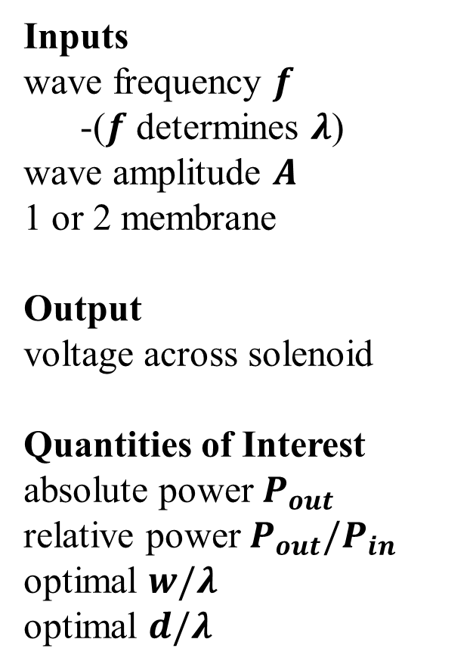
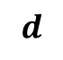
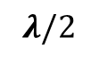
Final Design
$$λ/2$$
z
A
x
Inputs
wave frequency $f$
-($f$ determines $λ$)
wave amplitude $A$
1 or 2 membrane
Output
voltage across solenoid
Quantities of Interest
absolute power $P_{out}$
relative power $P_{out}/P_{in}$
optimal $w/λ$
optimal $d/λ$
$$d$$
w
How did we get here?
Notes:
Mention single vs double membrane here
Inputs: wave amplitude and frequency
Output: voltage
Quantities of interest
how do we quantify performance?
How did we get here?

Slide 8
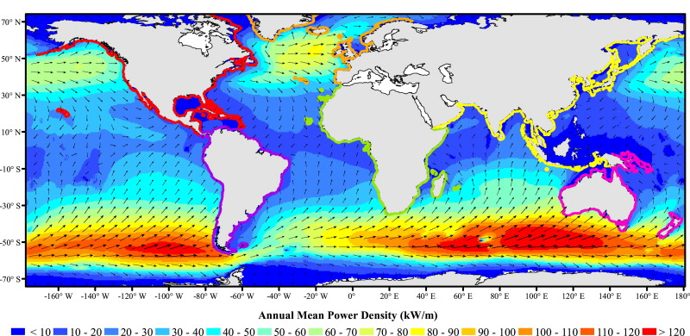
Motivation
Why…
… hydropower?
Low emission;
diversify renewables
portfolio
… a WEC? Untapped potential (2.11 ± 0.05 TW) [1]; less ecological disruption
… a flexible WEC? Fewer parts; young technology
Notes:
Why hydropower? low emission + diversify
Why a wave energy converter (WEC)? Untapped potential + less disruptive
Why flexible membrane? fewer parts + young field

Slide 9
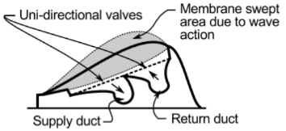
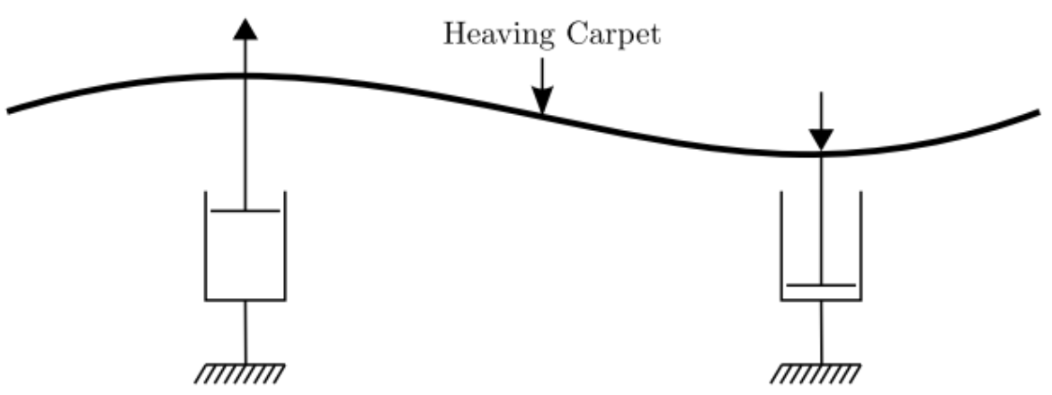
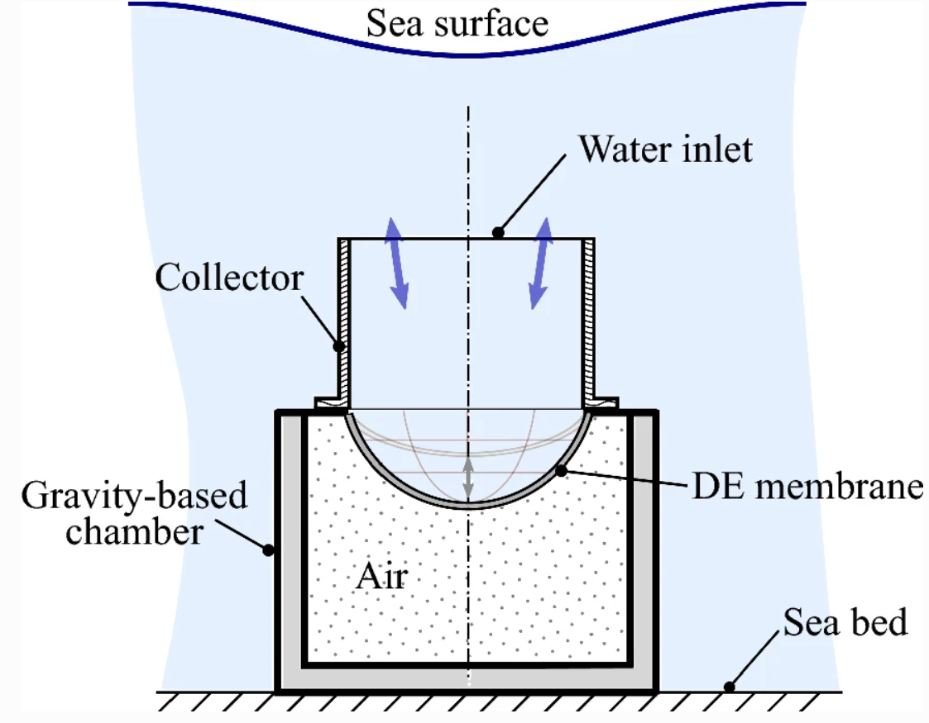
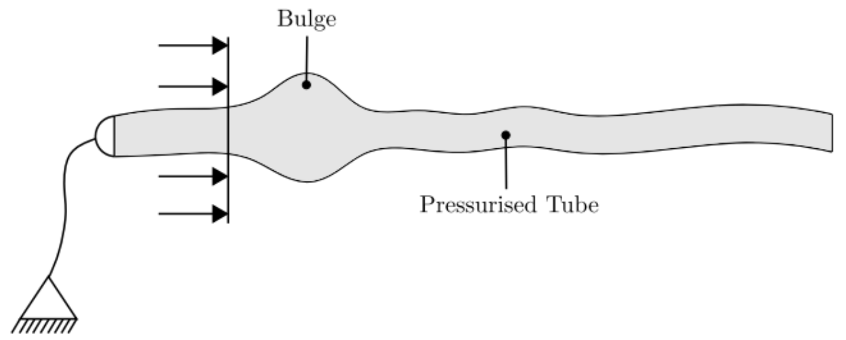
Existing flexible WEC Designs
Bombora mWave™ [3]
Carpet[2]
Column with DEG membrane
[4]
Peristaltic Tube [2]
Notes:
Carpet
Peristaltic tube
Bombora mwave
Most similar to ours
Array of membranes push air through turbine
DEG column
Came up with our own idea

Slide 10
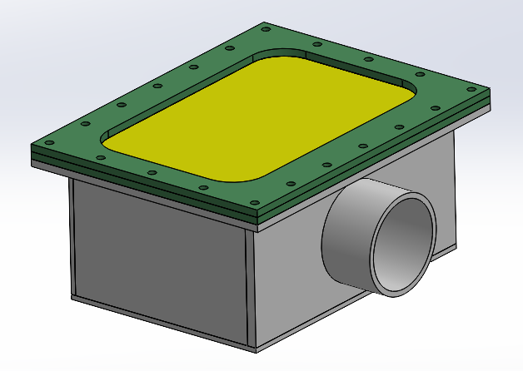
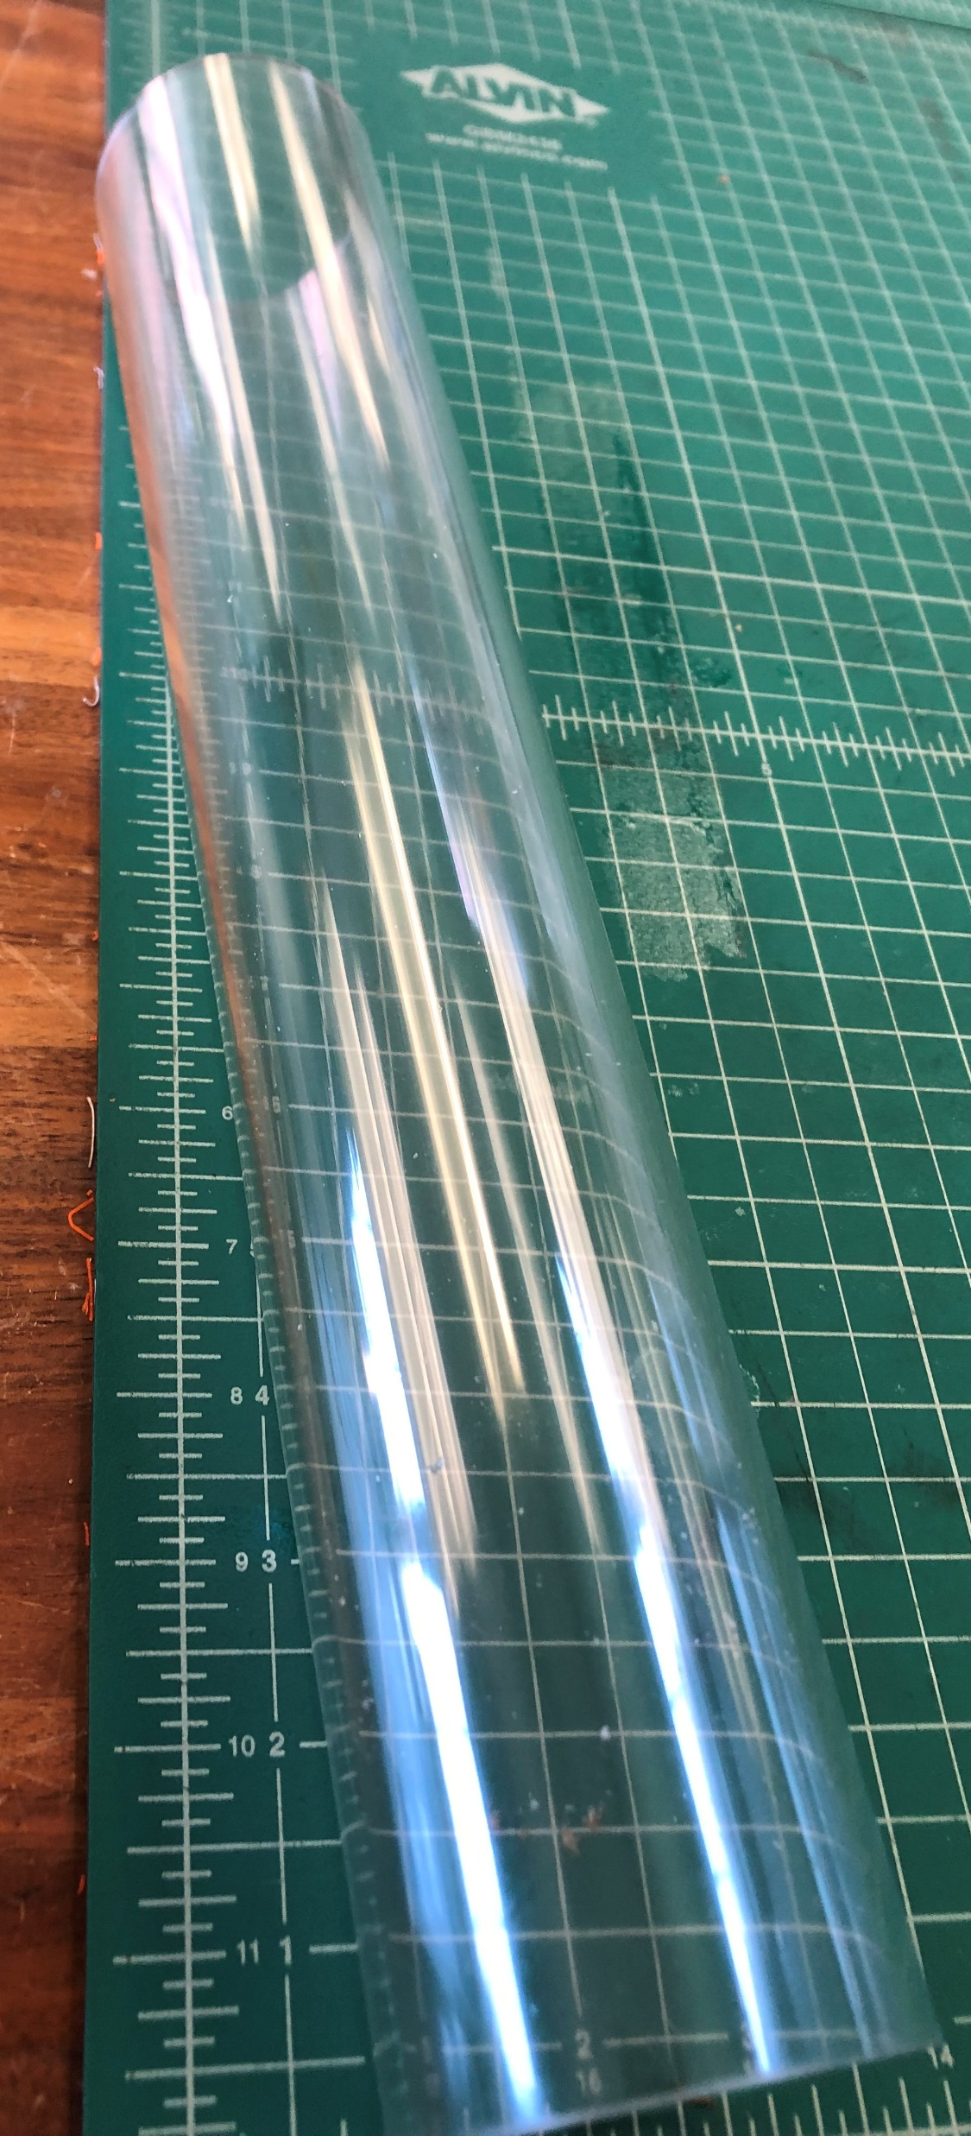
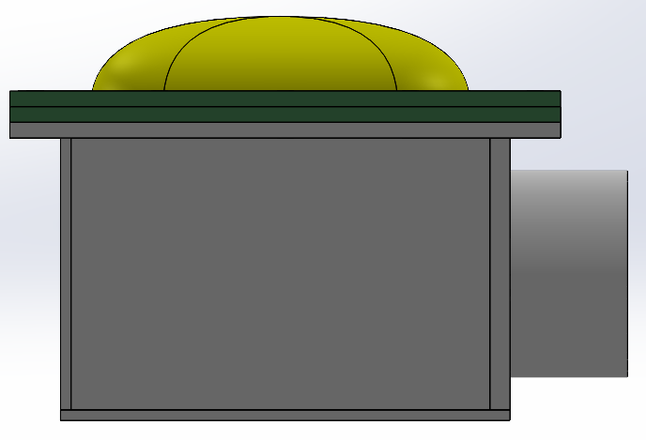
System Design
Key design considerations:
Box dimensions
Material selection
Membrane fastening
Tube length and diameter
Box/tube interface
Why have membranes at all?
Notes:
Ordered materials, CADed the system, laser cut the flat pieces, and glued the acrylic together using acrylic glue
Key design considerations (informed by mathematical model) (that I was primary decision maker of
Box dims (as short as possible, as long as possible, minimum width allowing for membrane)
Material selection (acrylic was natural) (3/16in)
Membrane picture frame (secure membrane, water proof box, interchangeable (for diff widths and 1 or 2 config)
Tube length and diameter (balancing inertia, piston travel distance, membrane swept area, length of channel, frequency band)
How to fit tubes and box together (removable, nearly water proof)
Why have membranes?
Separation of working fluid and environment
Elasticty in system helps return to neutral position

Slide 11
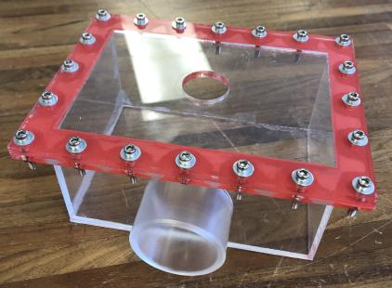
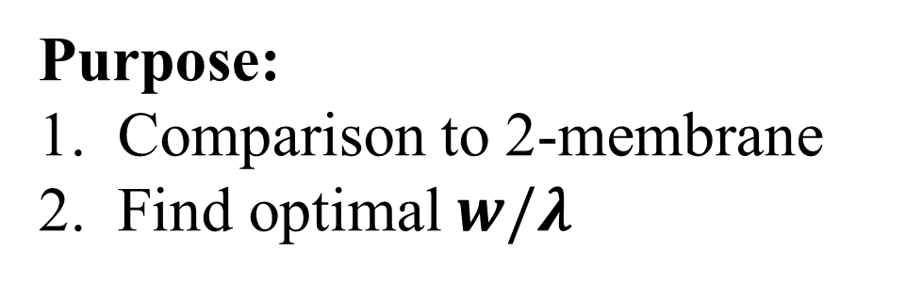
Single-Membrane Configuration
~constant pressure boundary
Purpose:
Comparison to 2-membrane
Find optimal $w/λ$
reservoir
z
x
tubing
w
Notes:
Explain constant pressure boundary
purpose

Slide 12
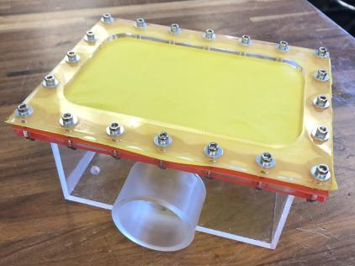
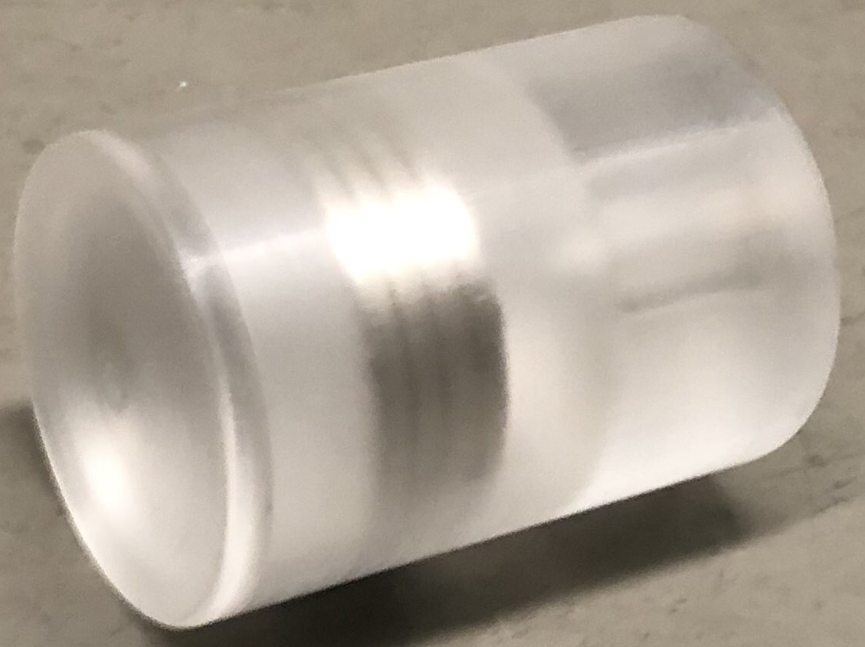
Assembled System
Notes:
Piston – David
Magnets – yifan
Configs – bottom pic in 1 membrane config

Slide 13
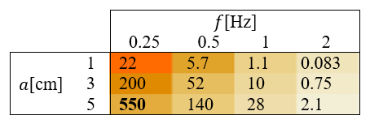


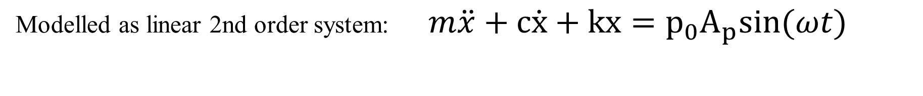
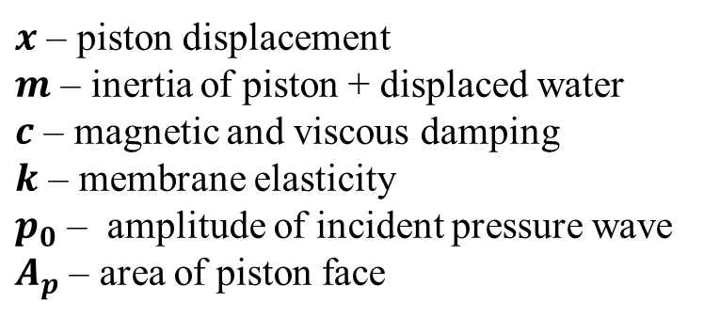
Mathematical Model
force
Modelled as linear 2nd order system: $m\ddot{x}+c\dot{x}+kx=p_{0}A_{p}sin(ωt)$
$x$ – piston displacement
$m$ – inertia of piston + displaced water
$c$ – magnetic and viscous damping
$k$ – membrane elasticity
$p_{0}$ – amplitude of incident pressure wave
$A_{p}$ – area of piston face
Assumptions
2D
sinusoidal plane wave
equal pressure on either side of membrane
0 fluid friction (!)
Predicted power generation [mW]
Max Efficiency: 19%
Min Efficiency: 0.02%
Notes:
Developed in parallel with system design
predictions + inform design decisions
membrane width, tube length and diameter, magnet strength
2nd order linear oscillator
Inertia, damping, elasticity, and forcing
What assumptions/simplifications were made (and what conditions is model thus most accurate in), strengths and weakness of model, what details are/aren’t captured by this model, predictive capabilities of this model

Slide 14
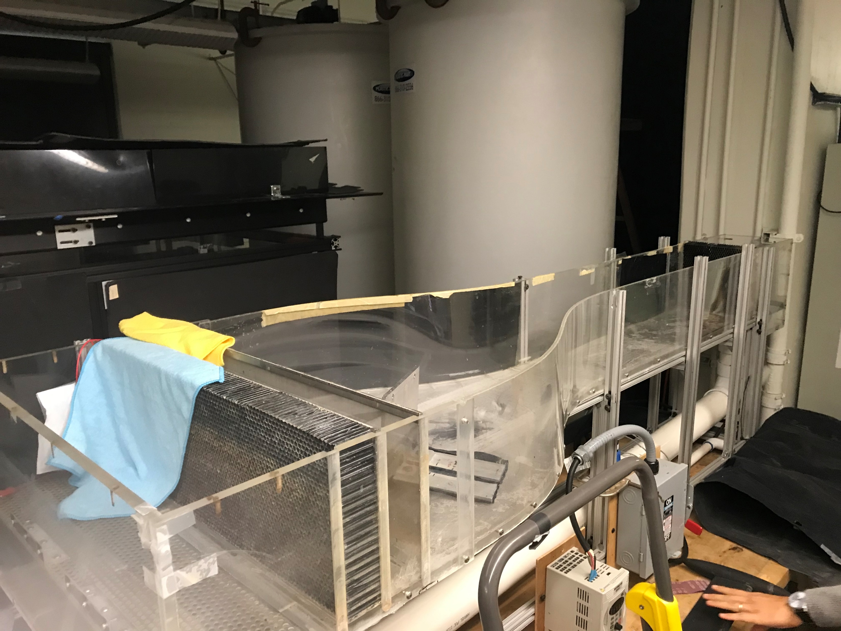
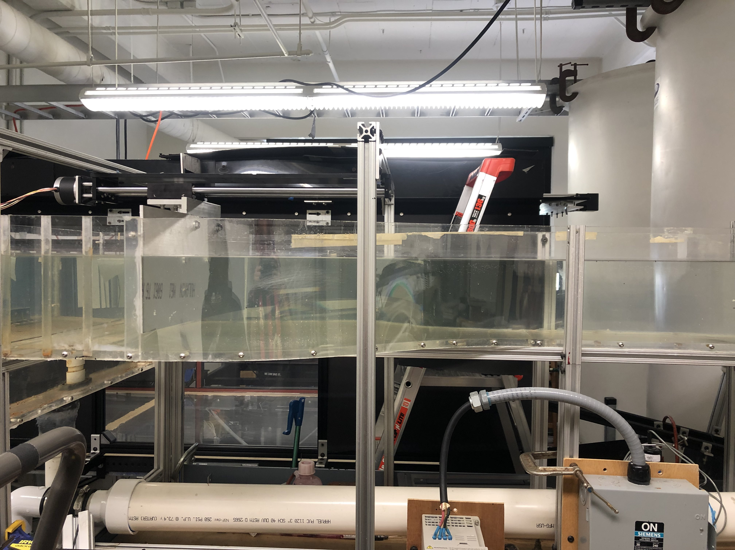
Experiment Design
Independent Variables:
Frequency
0.25 - 1Hz, 1/8 Hz step
Amplitude
small, med, large
Configuration
one or two membrane
Dependent Variable
Voltage(t)
Notes:
Wave maker
How did we mitigate human error in wave generation?
Damping beach

Slide 15
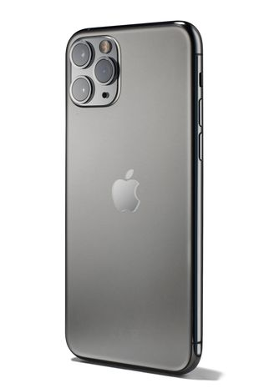
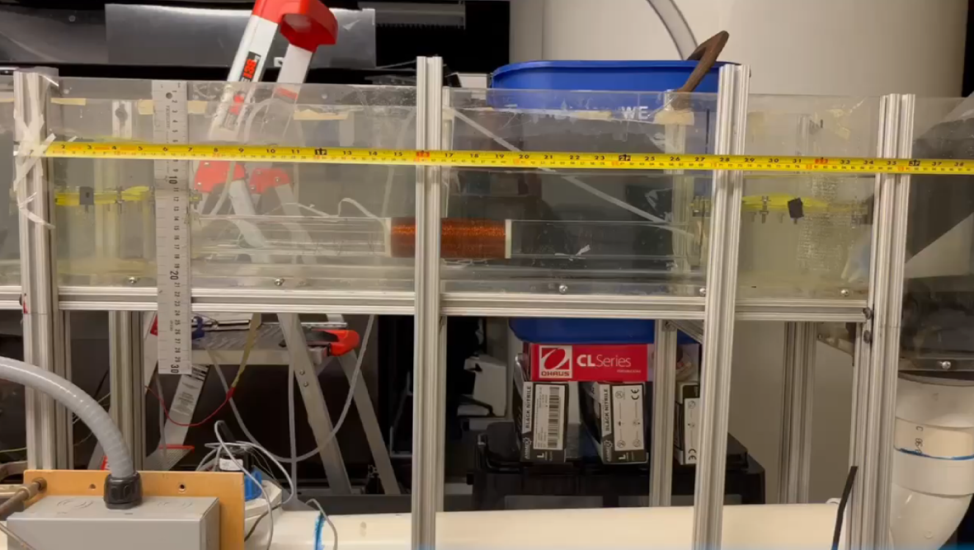
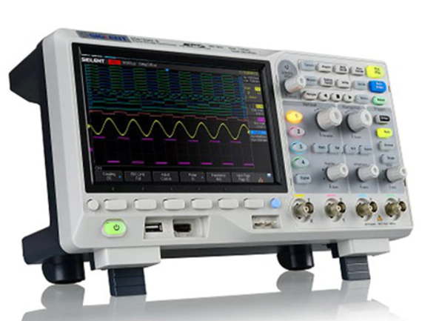
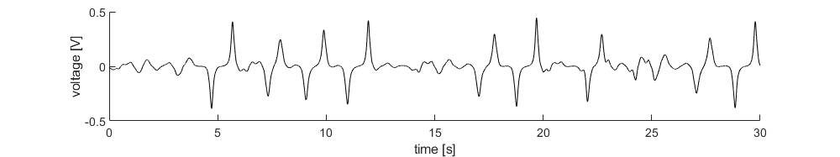
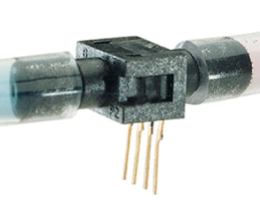
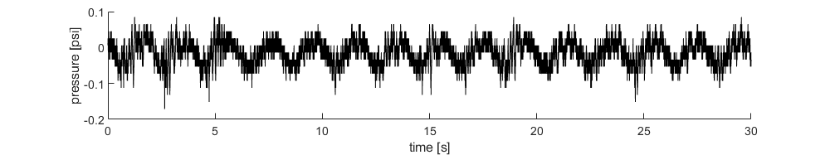
Experiment Setup – Data Collection
Phone camera
Oscilloscope
Differential pressure sensor
Notes:
Phone
Measure A and lambda
Oscilloscope
Diff Pressure sensor
Redundancy of data
Troubleshooting, Power could be backcalculate
Used an NIDaq to collect data

Slide 16
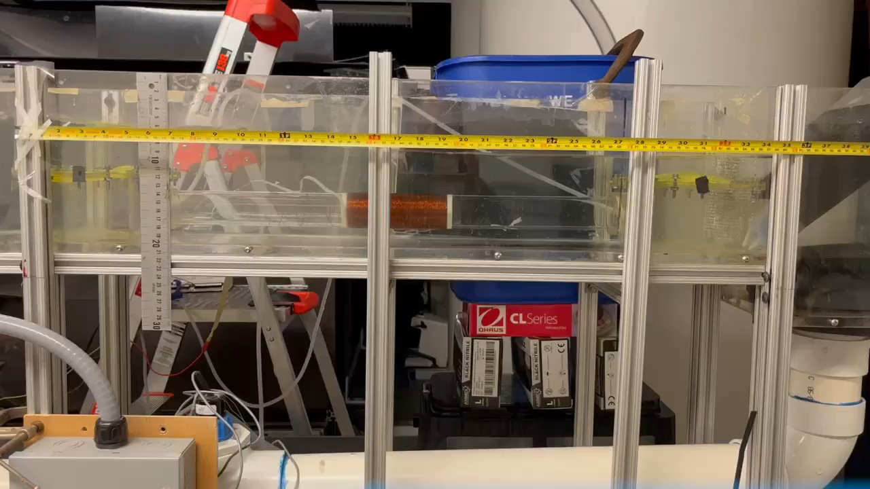
Notes:
Tape measure
Tube, boxes
Note, waves are not sinusoidal

Slide 17
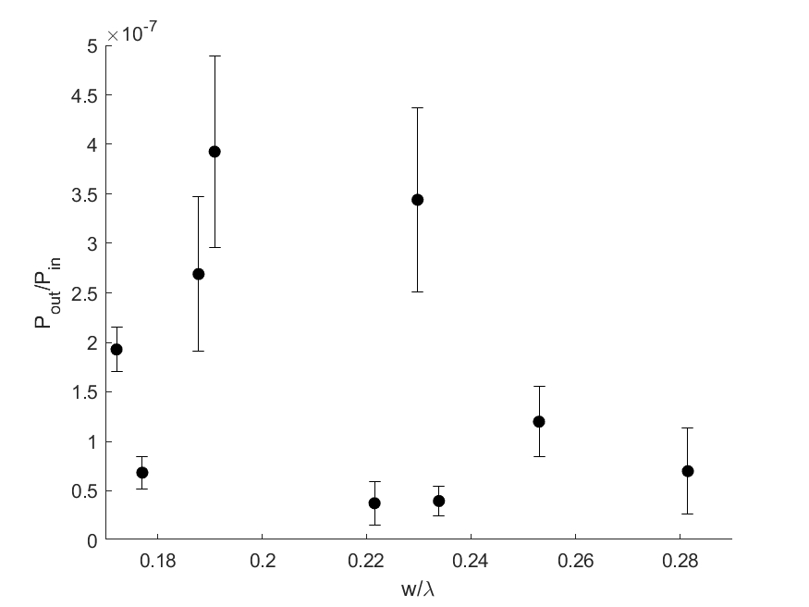
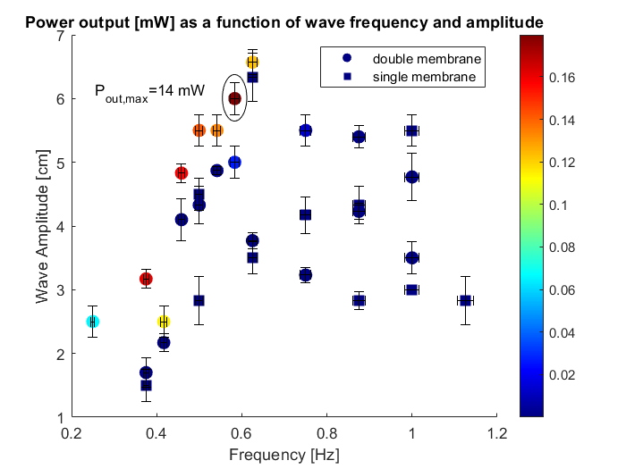
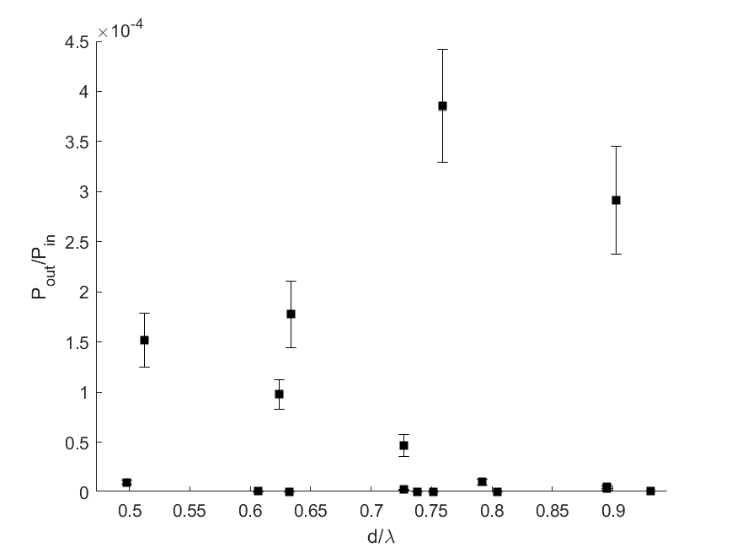
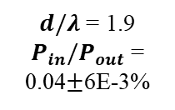


Results
1m wave, 0.04% → 4 W/m
(<lightbulb)
(!) single membrane → low efficiency
[mW]
$$w/λ$$
$d/λ$ = 1.9
$P_{in}/P_{out}$ = 0.04$±$6E-3%
$$d/λ$$
Notes:
Expected ideal d/lambda to be .5, but weren’t really able to replicate that due to equipment limitations
½ rho g a^2 – energy /wavelength/ meter crest
(1/2)rho g * (1m) *

Slide 18
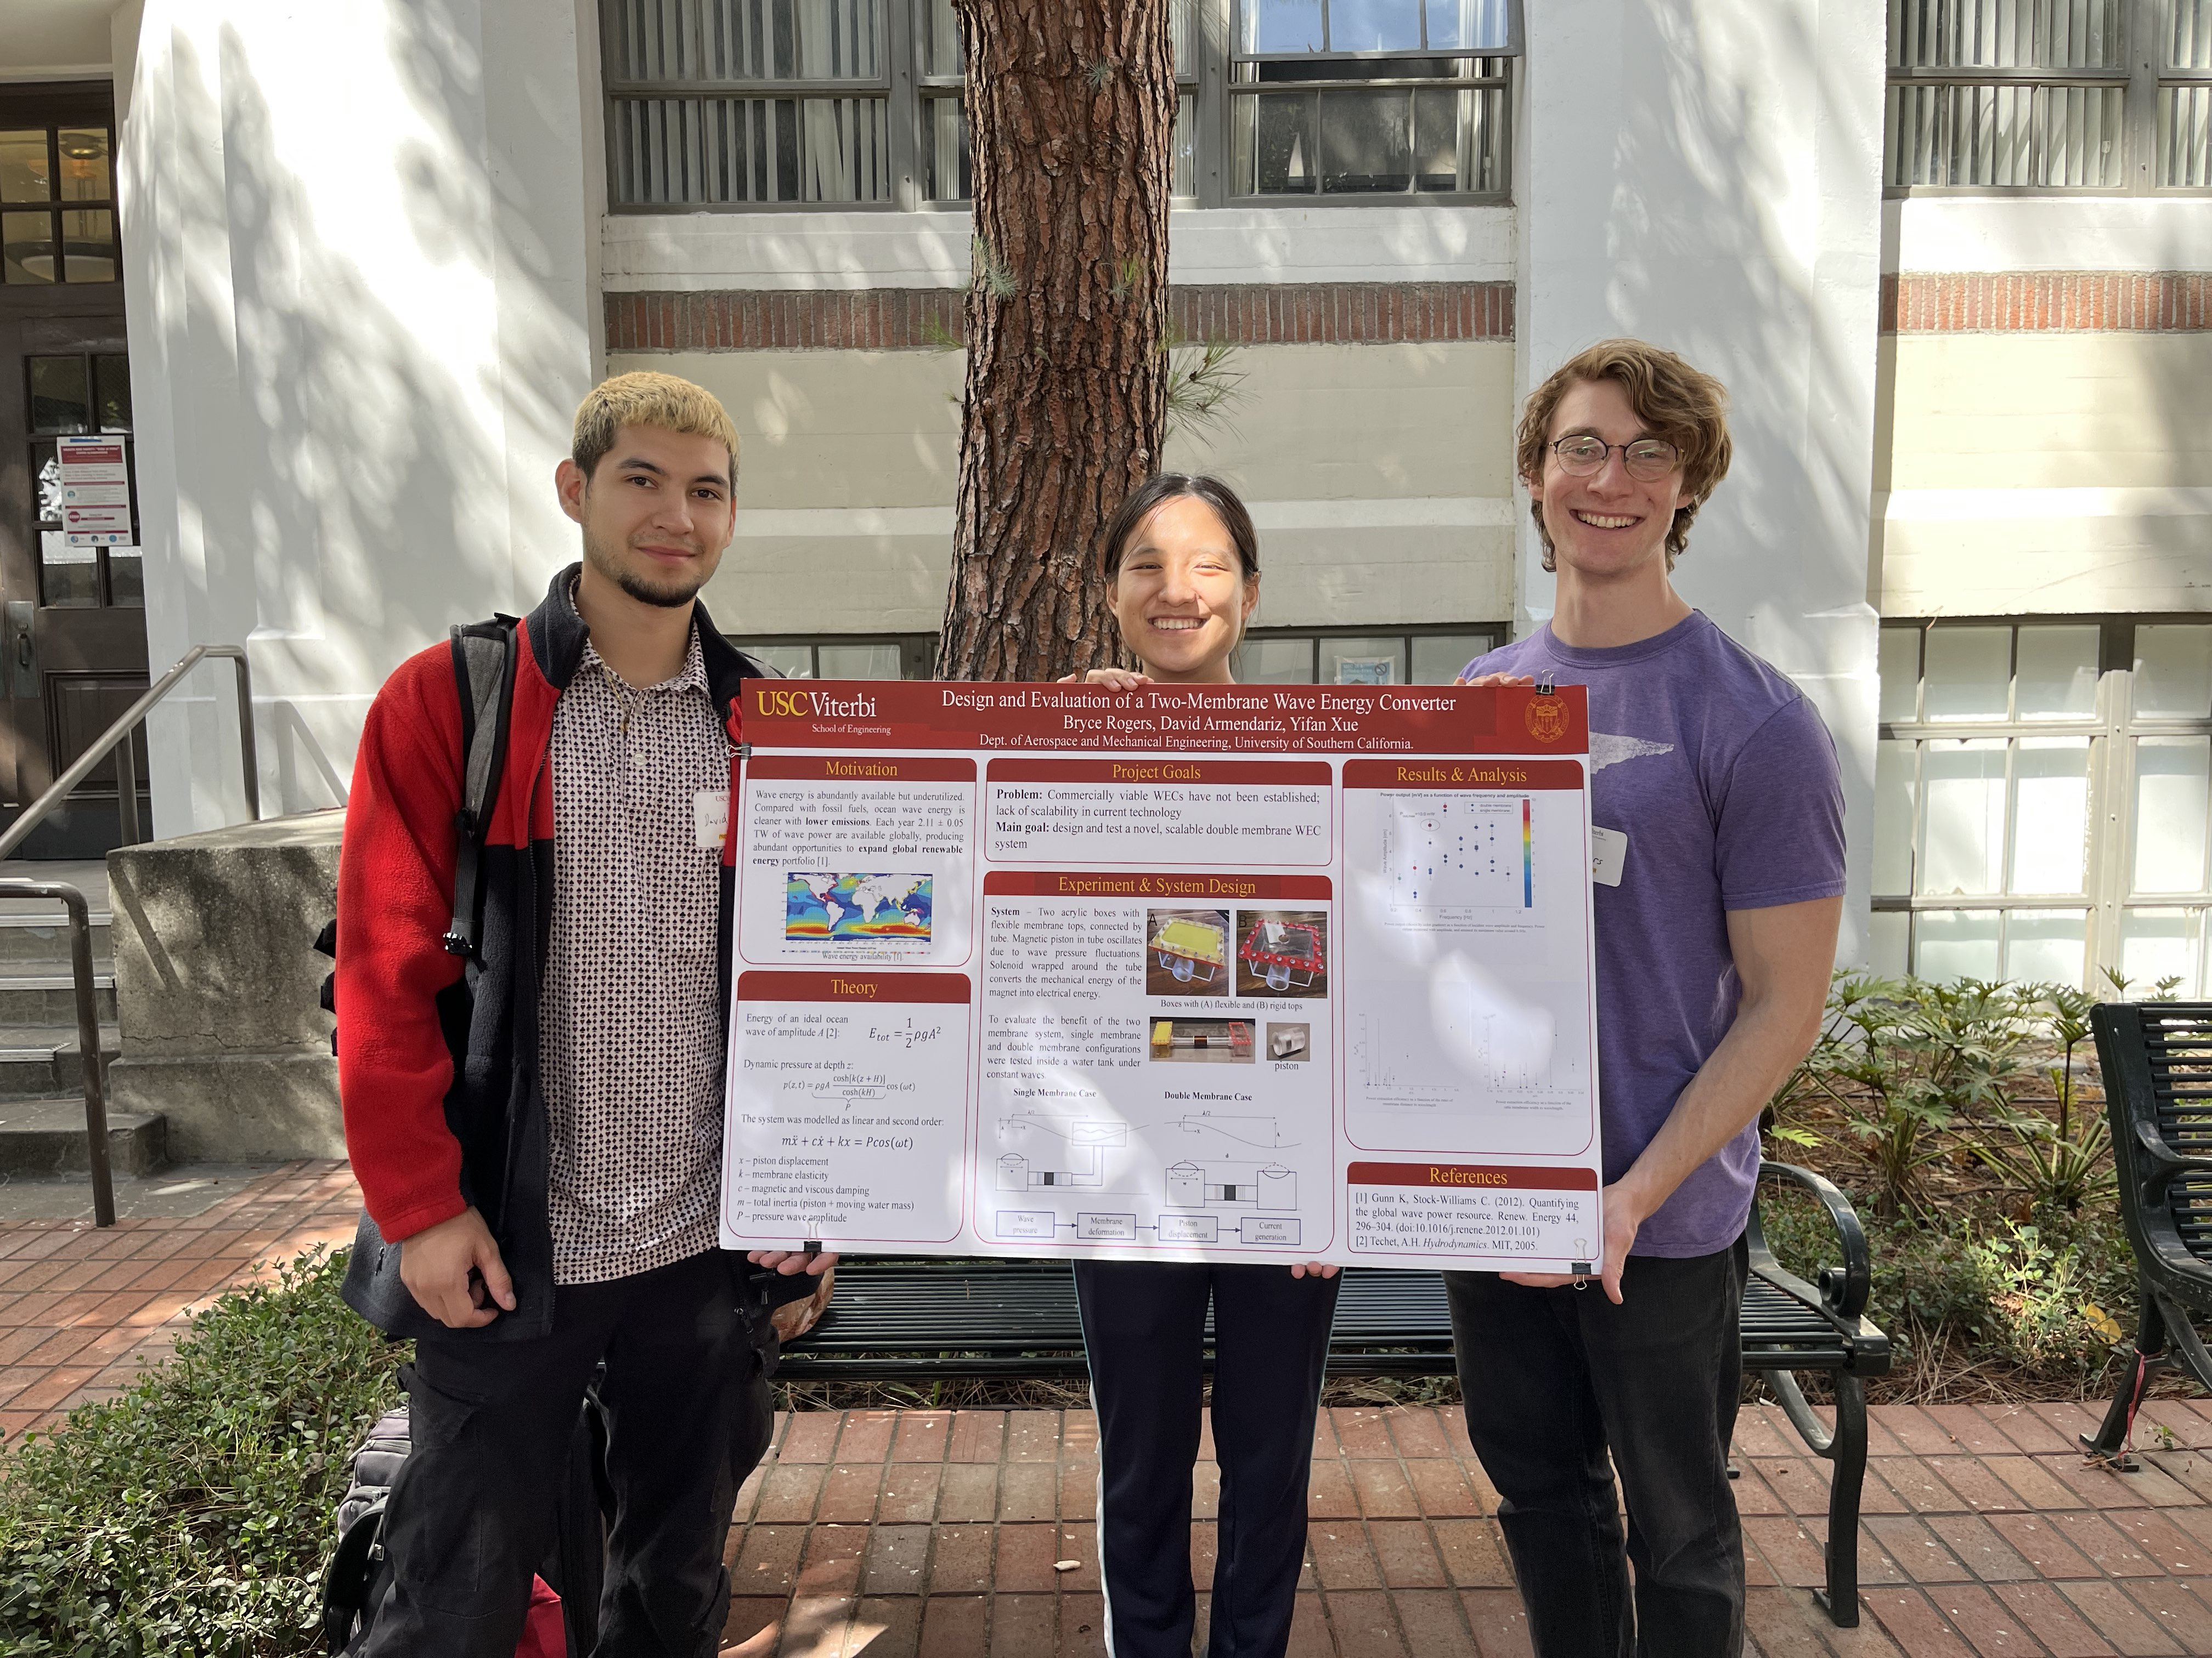
Hypothetical future steps
Determine if efficiency can be improved at scale
Validate power take off performance at scale
Resonant frequency dynamically tuned to incoming waves?
Notes:
Key uncertainties were future testing and product development undertaken
What would it take to scale up the device
What would the main challenges be? Could it be useful? Possible applications if technology became mature? It would be ok if there were none
How to get better shape of alternating current from irregular voltage waveform?

Slide 19
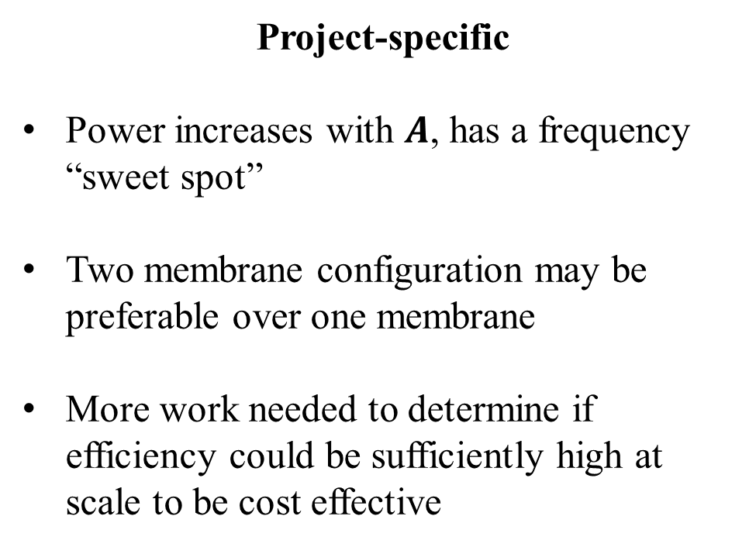
Key Takeaways
Project-specific
Power increases with $A$, has a frequency “sweet spot”
Two membrane configuration may be preferable over one membrane
More work needed to determine if efficiency could be sufficiently high at scale to be cost effective
Engineering in general
Robust theory and preparation essential to success
No decision can be made with 100% certainty, engineering judgements must be made to progress
Notes:
Project takeaways, engineering takeaways

Slide 20
Questions?
Special thanks to teammates Yifan Xue and David Armendariz
and to Professors Mitul Luhar, Darek Bogucki, and Robert Antypas

Slide 21
Works cited
[1] Gunn K, Stock-Williams C. (2012). Quantifying the global wave power resource. Renew. Energy 44, 296–304. (doi:10.1016/j.renene.2012.01.101)
[2] Collins, Ieuan, et al. “Flexible Membrane Structures for Wave Energy Harvesting: A Review of the Developments, Materials and Computational Modelling Approaches.” Renewable and Sustainable Energy Reviews, vol. 151, 2021, p. 111478., https://doi.org/10.1016/j.rser.2021.111478.
[3] Ryan, S., et al. The Bombora Wave Energy Converter: A Novel Multi-Purpose Device for Electricity, Coastal Protection and Surf Breaks: Semantic Scholar. 1 Jan. 1970, https://www.semanticscholar.org/paper/The-Bombora-wave-energy-converter%3A-A-novel-device-Ryan-Algie/a8925cdc5b07e026cd1fb8916c56008d3c4f5d50.
[4] Righi, Michele, et al. “A Broadbanded Pressure Differential Wave Energy Converter Based on Dielectric Elastomer Generators.” Nonlinear Dynamics, vol. 105, no. 4, 2021, pp. 2861–2876., https://doi.org/10.1007/s11071-021-06721-8.

